Slide 1
Decision Tree Modeling in R
Decision Modeling in R workshop
July 2020

Slide 2
Building Decision Models in R
Notes:
Eline

Slide 3
Decision Tree (a type of model)
Schematic representation of all of the important outcomes of a decision (e.g., clinical, economic, non-health sectors)
Used to combine knowledge about decision problem from many sources
Computes average outcomes (e.g., costs, events, QALYs) from decisions

Slide 4
Components of a decision tree
The alternative strategies of a decision making process
The events that follow from application of any of these strategies and their likelihood
The outcomes (for an individual, a cohort or a population)

Slide 5
Structure of a decision tree
A tree consists of 3 different types of nodes connected via branches:
A decision tree starts with a decision node, which represents the choices a decision maker has between mutually exclusive strategies
A chance node represents possible events that could occur following a decision or a previous event. We include probabilities of these events in the tree.
A terminal node represents end points of each complete branch and the outcome associated with it.

Slide 6
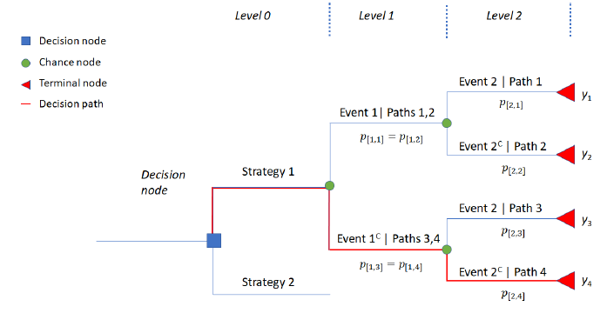
Plot of a sample decision tree

Slide 7
Compute average outcomes
The expected value (average) of the outcomes (i.e. cost, QALYs) of a strategy in a decision tree can be calculated by using the below steps:
Identify all branches in this strategy
Multiply all conditional probabilities in a branch
The product of all conditional probabilities is then multiplied with the outcome value of that branch
Repeat steps 2 and 3 for each branch
Sum (the product of conditional probabilities x outcome) for all branches under this strategy

Slide 8
Compute average outcomes – in R
The steps to calculate expected outcome(s) could be done easily in R in the following way:
Store the product of all conditional probabilities of each branch in a vector
Store the associating outcomes in a vector
Take the product of the two vectors using matrix multiplication.

Slide 9
Simple Decision Tree
Viral encephalitis can be caused by herpes virus (HVE) or other viruses (OVE); Pr(HVE) = 52%.
Untreated HVE leads to severe sequelae in 71%; for OVE the figure is 1%.
A drug, vidarabine, decreases severe sequelae due to HVE from 71% down to 36%.
Side effects cause an increase in severe sequale among OVE patients treated with vidarabine from 1% to 20%.

Slide 10
Draw the tree

Slide 11
There is a third option
It is possible to obtain a definitive diagnosis by means of brain biopsy, but this procedure itself carries a risk of mortality of 0.5%.

Slide 12
Draw the tree

Slide 13
R Session
Notes:
Part 1 = Showing code 3 state model
Part 2 = Exercise build Sick-Sicker model
Part 3 = Show answers of Sick-Sicker

